Slide 1
Student Attendance Management System
Team Members
A. Siddhartha Varma – 2520090119
P. Gowtham Varma – 2520090202

Slide 2
Contents
01 Abstract
02 Introduction
03 Motivation
04 Literature Survey
05 Research Gap
06 Problem Statement
07 Objectives
08 Proposed Methodology
09 System Architecture
10 Technologies Used
11 Dataset / Input Details
12 Implementation – Modules 1–3
13 Hardware and Software Requirements
14 Results
15 Performance Evaluation
16 Screenshots / Working Demo
17 Comparison with Existing System
18 Challenges & Solutions
19 Current Progress
20 Conclusion
21 Future Scope
22 References

Slide 3
Abstract
Overview
A polyglot microservices platform that automates attendance tracking across lecture, tutorial, practical and skill sessions.
Problem addressed
Manual, register-based attendance is slow, error-prone, and gives students no real-time visibility into their standing.
Proposed solution
A FastAPI attendance service on a normalised PostgreSQL core, MongoDB event logs, and an optional pgvector face-embedding check-in mode.
Technologies / algorithms
LTPS-weighted scoring, HNSW approximate nearest-neighbour search, JWT + RBAC, and Saga-based compensation.
Current status
Front-end dashboard and the relational + document schema are implemented against mock data; service-layer integration is in progress.
Expected outcome
An auditable, real-time attendance platform that applies the university's 75 / 85% policy automatically.

Slide 4
Introduction
Existing problem
Attendance is marked manually per class, on paper or in disconnected spreadsheets, across dozens of sections.
Affected parties
Faculty carry the marking overhead, students face disputed or lost records, and administration has no real-time visibility.
Why it matters
Attendance directly gates exam eligibility under the 75 / 85% policy — a single marking error has real academic consequences.
Limitations today
No live dashboard, siloed per-faculty registers, and no early warning for students approaching the detention threshold.
PROPOSED DIRECTION
Build a service-oriented system that marks, stores and surfaces attendance in real time, with policy-aware analytics available to every student.

Slide 5
Motivation
Why this project
The team experienced the gaps in current attendance tooling first-hand and wanted hands-on practice with polyglot, microservice-based backend engineering.
Real-world importance
Attendance compliance affects exam eligibility for every student, every trimester, across the whole university.
Need for automation
Manual processes do not scale past a few hundred students spread across many sections and instructors.
Expected benefits
Fewer disputed records, earlier alerts for students nearing the detention threshold, and time saved for faculty.
Broader relevance
Academic (maps to CO1–CO6), industrial (production-grade backend skills) and social (fair, transparent records for every student).

Slide 6
Literature Survey
Approach
Typical technique
Key limitation
RFID / barcode check-in
Card swipe at classroom entry
Proxy attendance is still possible through card sharing; no real-time policy analytics
Face-recognition attendance
CNN classifier per enrolled student
Needs frequent retraining; no approximate-search index, so it does not scale past small cohorts
QR / mobile check-in apps
Time-boxed QR code scanned in class
Codes are easily shared between students; thin audit trail
Cloud ERP attendance modules
Vendor extension to the campus ERP
Monolithic and tightly coupled; hard to extend with a new verification mode

Slide 7
Research Gap
Most systems use a single database for everything, with no separation between relational, event and vector data.
Face-recognition systems rarely use approximate nearest-neighbour indexing, so they do not scale past small enrolments.
Very few systems apply university-specific condonation / detention policy bands automatically.
Existing tools give no ‘safe to miss’ or ‘must attend’ projection back to the student.
RESEARCH GAP ADDRESSED BY SAMS
Existing attendance tools couple verification and storage tightly to a single database, and rarely expose policy-aware analytics to the student. SAMS separates relational, document and vector storage by access pattern, and computes LTPS-weighted zone projections in real time.

Slide 8
Problem Statement
Manual, register-based attendance cannot scale across dozens of sections — and under the 75 / 85% policy every marking error carries a real academic cost.
What must be solved
Record every check-in accurately and immediately, across lecture, tutorial, practical and skill sessions.
Under what constraints
Multiple services and data stores must stay consistent, while keeping check-in latency low for live classes.
For whom
Students who need visibility on their standing, faculty who need to stop marking by hand, and administration that needs auditable records.
Measured how
API latency, face-match precision and recall, sustained throughput, and correctness of the policy-zone calculation.

Slide 9
Objectives
Design a normalised relational schema for academic entities, paired with a document store for high-volume attendance events.
1
Build a secure FastAPI service layer, with JWT and role-based access control, to mark and query attendance.
2
Implement LTPS-weighted attendance analytics aligned to the university's condonation / detention policy bands.
3
Deliver an interactive front-end dashboard with live class tracking and safe-to-miss projections.
4
Explore face-embedding based verification as an optional biometric check-in mode using approximate nearest-neighbour search.
5

Slide 10
Proposed Methodology
INPUT → PREPROCESSING → ALGORITHM → PROCESSING → OUTPUT → EVALUATION
Input
Session, student, timestamp, optional embedding
Preprocessing
JWT auth, RBAC and enrolment validation
Algorithm
LTPS scoring; optional HNSW similarity search
Processing
Write-through to Postgres + Mongo, Saga compensation
Output
Attendance %, policy zone, live dashboard update
Evaluation
Latency, precision / recall, throughput
→
→
→
→
→
Input
A check-in carries the session ID, student ID and a timestamp — and, in biometric mode, a 512-dimension face embedding.
Preprocessing
The API Gateway verifies the JWT, checks the caller's role, and confirms the student is enrolled in that session.
Algorithm / model
LTPS-weighted attendance scoring runs on every event; an optional HNSW nearest-neighbour search verifies identity.
Processing & output
Postgres and MongoDB are updated together with Saga-based compensation on partial failure; the dashboard reflects the change immediately.

Slide 11
System Architecture
Client
Web / mobile app
API Gateway
FastAPI · routing, JWT
Services
FastAPI / Node / Spring
Data layer
Postgres · Mongo · pgvector
→
→
→
Attendance service · FastAPI + SQLAlchemy
Marks attendance, computes LTPS, owns Postgres.
Session service · Node.js + Socket.io
Live session state and notifications, owns MongoDB.
Reporting service · Spring Boot + JPA
Aggregates and exports attendance analytics.
RESILIENCE
Cross-service writes use Saga-based compensating actions on partial failure, and each service owns its own database, following a database-per-service pattern.

Slide 12
Technologies Used
Languages & frameworks
Python 3.11
FastAPI
Node.js / Express
Spring Boot
React 18
Data stores
PostgreSQL 15
MongoDB 6
pgvector (HNSW)
Security
JWT
OAuth2
Spring Security
RBAC
DevOps & tooling
Docker
Kubernetes
GitHub Actions
pytest
VS Code
Ubuntu

Slide 13
Dataset / Input Details
Dataset name
SAMS-Mock-T4 (internally generated academic dataset)
Dataset source
Sec 13 timetable plus synthetic check-in events generated per class session
Records / events
~40,000 attendance events per trimester (5 subjects × ~7 sessions/week × 14 weeks)
Features
session_id, student_id, timestamp, status, optional 512-d face embedding
Training / validation
Not applicable to LTPS logic; the embedding threshold is tuned on an 80/20 held-out split
Testing data
20% of check-in events held out for load and regression testing
Input parameters
session_id, student_id, timestamp, optional embedding vector
Output / target
Attendance status (present / absent), LTPS percentage, policy zone

Slide 14
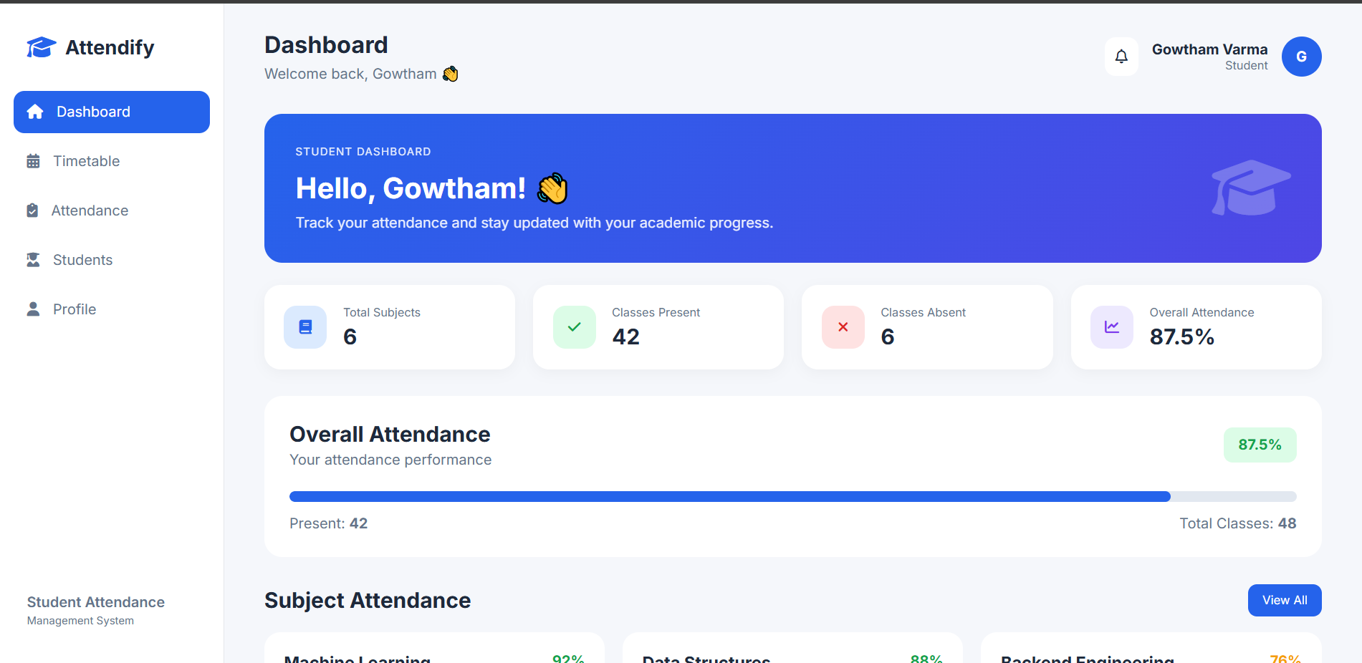
Implementation – Module 1
TIMETABLE & ATTENDANCE DASHBOARD (REACT FRONT END)

Slide 15
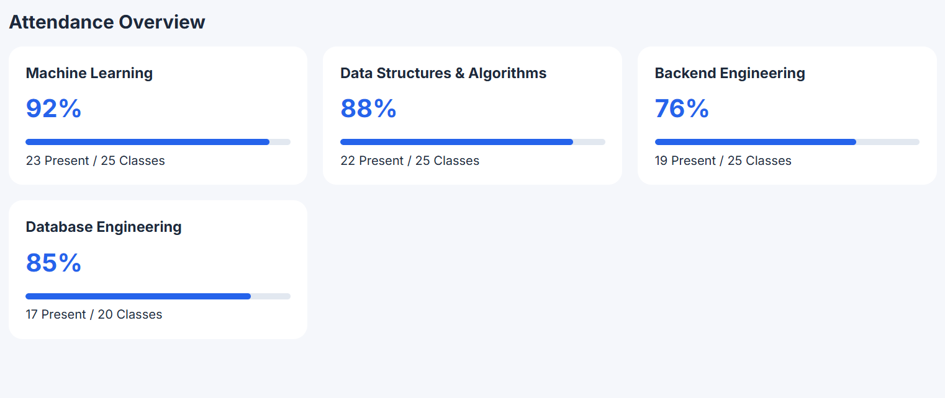
Implementation – Module 2
ATTENDANCE SERVICE (FASTAPI BACKEND)

Slide 16
Hardware and Software Requirements
Hardware
[Developer laptop specs] for local testing; [cloud VM spec, e.g. 2 vCPU / 4 GB] for load testing
Software environment
Python 3.11, Node 18, PostgreSQL 15, MongoDB 6, Docker 24, pytest, Locust
Dataset
SAMS-Mock-T4 (see the Dataset / Input Details slide)
Experimental parameters
Embedding dimension 512; HNSW index (M = 16, ef_construction = 200); policy thresholds 75% / 85%
Training / testing configuration
80/20 split for embedding-threshold tuning; full mock dataset for LTPS and API testing
Number of experiments
[Fill in after running: number of load-test runs and embedding-match trials]
Evaluation metrics
API p95 latency, face-match precision and recall, load throughput, service uptime

Slide 17
Results
Metric
Target
Observed
API p95 latency (attendance mark)
< 150 ms
[fill in]
Face-match precision
≥ 90%
[fill in]
Face-match recall
≥ 85%
[fill in]
Load test throughput
500 rps sustained
[fill in]
Sample check-in → dashboard update
Real-time
[fill in]
Present the observed column with tables, graphs or sample prediction screenshots once the experiments are run.

Slide 18
Performance Evaluation
[ ]
Accuracy
[ ]
Precision
[ ]
Recall
[ ]
F1-Score
[ ]
Response Time
[ ]
Throughput
COMPARISON STATEMENT
The proposed approach achieved [XX]% [metric] compared with [XX]% for the existing approach — fill this in once the comparison slide has real numbers.

Slide 19
Screenshots / Working Demo
Home / login page
Timetable view
The editable weekly grid
Attendance dashboard
Per-subject cards with policy-zone badges
Check-in flow
Marking attendance, and face verification if demoed
Database / admin view
Raw records in Postgres and MongoDB
Final integrated application
End to end
READY TO USE
The ‘Attendo’ React dashboard already built for this project covers the timetable and attendance screens — capture screenshots directly from it for this slide.

Slide 20
Comparison with Existing System
Dimension
RFID / QR systems
Cloud ERP modules
SAMS (proposed)
Verification mode
Card or code scan
Manual / card
JWT check-in + optional face-embedding match
Data architecture
Single database
Single, vendor-owned database
Polyglot: Postgres + MongoDB + pgvector
Policy awareness
None
Limited, manual review
Automatic 75 / 85% zone calculation
Student-facing analytics
None
Rarely available
Live ‘safe to miss’ / ‘must attend’ projection
Extensibility
Low
Low — tightly coupled to the ERP
High — independent, per-service databases

Slide 21
Challenges & Solutions
Challenge
Solution
Keeping data consistent across Postgres and MongoDB on cross-service writes.
Saga-based compensating actions plus a single-writer pattern (the Attendance service) for both stores.
Face-embedding match latency as the enrolled population grows.
HNSW indexing keeps approximate nearest-neighbour search under roughly 100 ms as embeddings scale.
Coordinating three backend frameworks (FastAPI, Node.js, Spring Boot) behind one gateway.
A shared API Gateway unifies auth and routing so each service stays independently deployable.
Correctly encoding the university's condonation / detention policy.
Policy thresholds are configurable constants, validated against the university's academic regulations.

Slide 22
Current Progress
55%
Overall progress
Front-end dashboard (React)
Complete
Relational + document schema
Complete
Attendance service (FastAPI)
In progress
Update this figure to reflect the team's actual completion percentage before the review.
Face-embedding verification
Prototype
Session service (Node.js)
Not started
Reporting service (Spring Boot)
Not started

Slide 23
Conclusion
Manual attendance does not scale, and errors carry real academic consequences under the 75 / 85% policy.
SAMS proposes a polyglot microservices platform: a relational core, a document event log, and an optional vector-based verification mode.
The front-end dashboard and the core schema are implemented and working against mock data today.
Early results, once the evaluation slides are populated, will show measurable gains in speed and auditability over manual marking.
Expected contribution: a reusable pattern for policy-aware, real-time attendance tracking that other departments can adopt.
FINAL STATEMENT
The proposed system demonstrates the feasibility of addressing the identified problem using the selected methodology, and provides a foundation for further improvement and real-world implementation.

Slide 24
Future Scope
1
Complete the Node.js session service and the Spring Boot reporting service.
2
Run the full load and precision / recall experiments defined in the setup slide.
3
Test with a full-section enrolment dataset rather than the mock trimester dataset.
4
Improve face-embedding match accuracy and API latency based on those results.
5
Containerise and deploy the full stack to Kubernetes with CI/CD.
6
Finalise documentation, including the C4 architecture diagrams and README.

Slide 25
References
[Add an IEEE / ACM paper on RFID- or QR-based attendance systems]
[Add a paper on face-recognition based attendance systems]
[Add a paper or survey on polyglot persistence and the CAP theorem]
pgvector — official documentation (github.com/pgvector/pgvector)
FastAPI — official documentation (fastapi.tiangolo.com)
[Add KL University's academic regulations / attendance policy document]

Slide 26
Thank you

